Slide 1
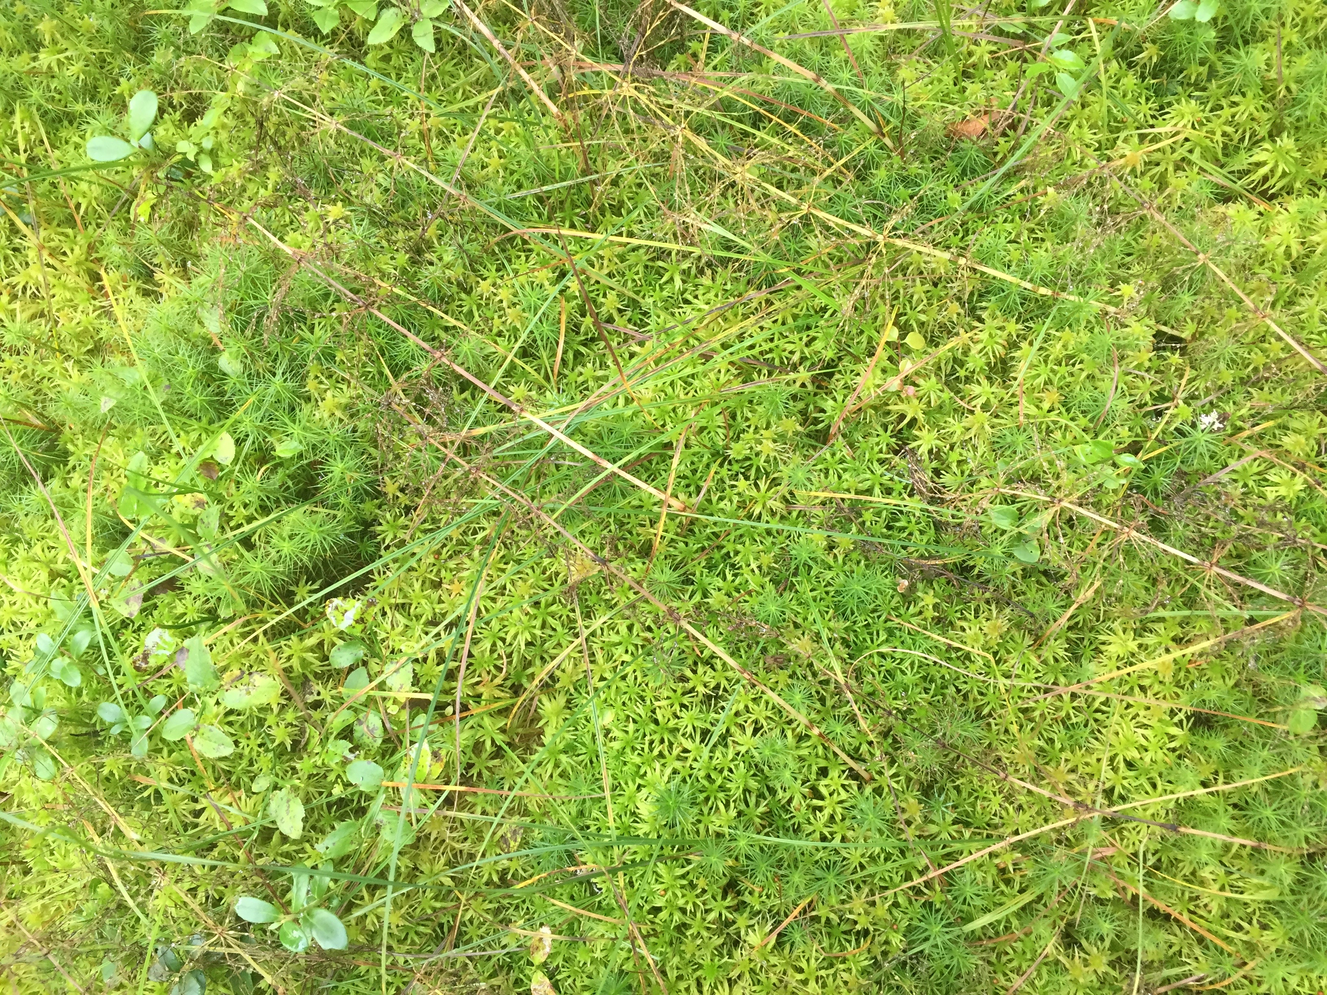
Climate impacts of bryophytes: from functional traits to global models
Antti-Jussi Kieloaho
Samuli Launiainen

Slide 2
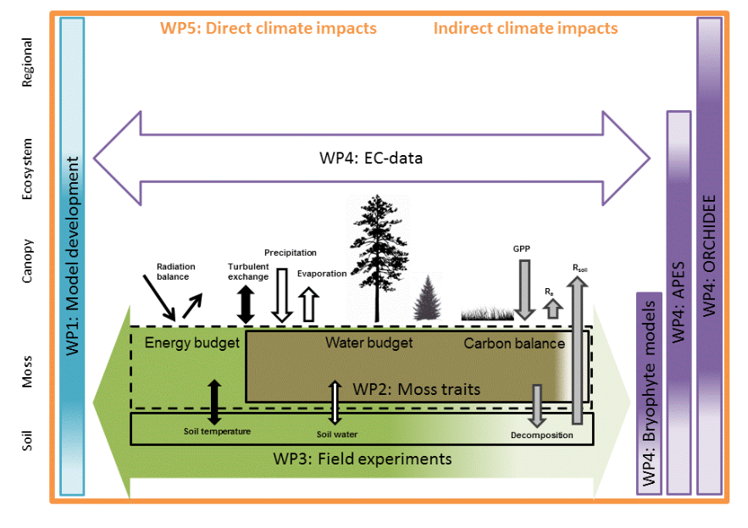
Climate impacts of bryophytes: from functional traits to global models
Pinpoint the most important functional traits of the bryophyte layer
Hydrological properties
Optical and thermal properties
Carbon usage
Start with APES + develop description further bryophyte layer
Energy and water balance
Photosynthesis, respiration, growth
Put mosses into a climate model
Orchidee?
Regional climate impacts
CLIMOSS (2016-2021, Acad. Finland)

Slide 3
APES – Atmosphere-Plant Exchange Simulator
Backbone of CLIMOSS project
1-dimensional multi-layer and multi-species soil-vegetation-atmosphere model with separate bryophyte layer (Launiainen et al., 2015)
Bryophyte layer is being improved
Hydration status affect optical properties
Bimodal water retention (micro and macro pore system)
Coupled hydraulic properties
Carbon exchange Farquhar –type carbon exchange will be added in near future

Slide 4
Optical and hydraulic properties
Gravimetric and volumetric water contents are fixed:
Field capacity (-0.01 m) divides micro and macro pore systems
Air dry moss (-1000 m) is fixed with residual water content
Optical properties:
Reflected photosynthetic active radiation (PAR) and near infrared radiation (NIR) depends on hydration status of a bryophyte

Slide 5
The first stage of testing model performance
Measurements from Scots Pine forest stand (Hyytiälä SMEAR II station) located in Southern Finland (61.52º N, 24.17º E)
Test period was from May 2005 to September 2005
bryophyte characteristic traits (moss layer thickness, bulk density, and roughness height) were changed one at the time
Hyloconium splendens was chosen to be a typical bryophyte
Varying light and hydraulic conditions
1-sided leaf area index of canopy (from 0.0 to 6.0 m² m⁻²)
ground water level (from 0.0 to -4.0 m)

Slide 6
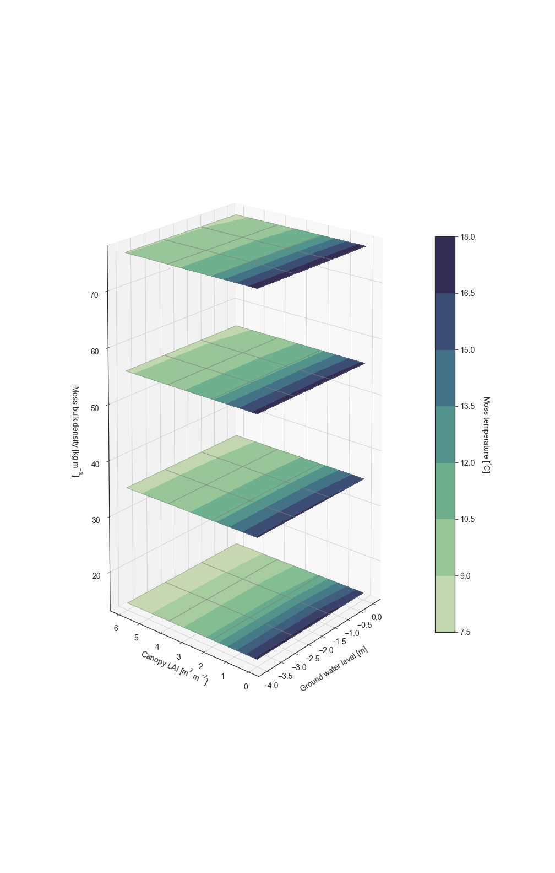
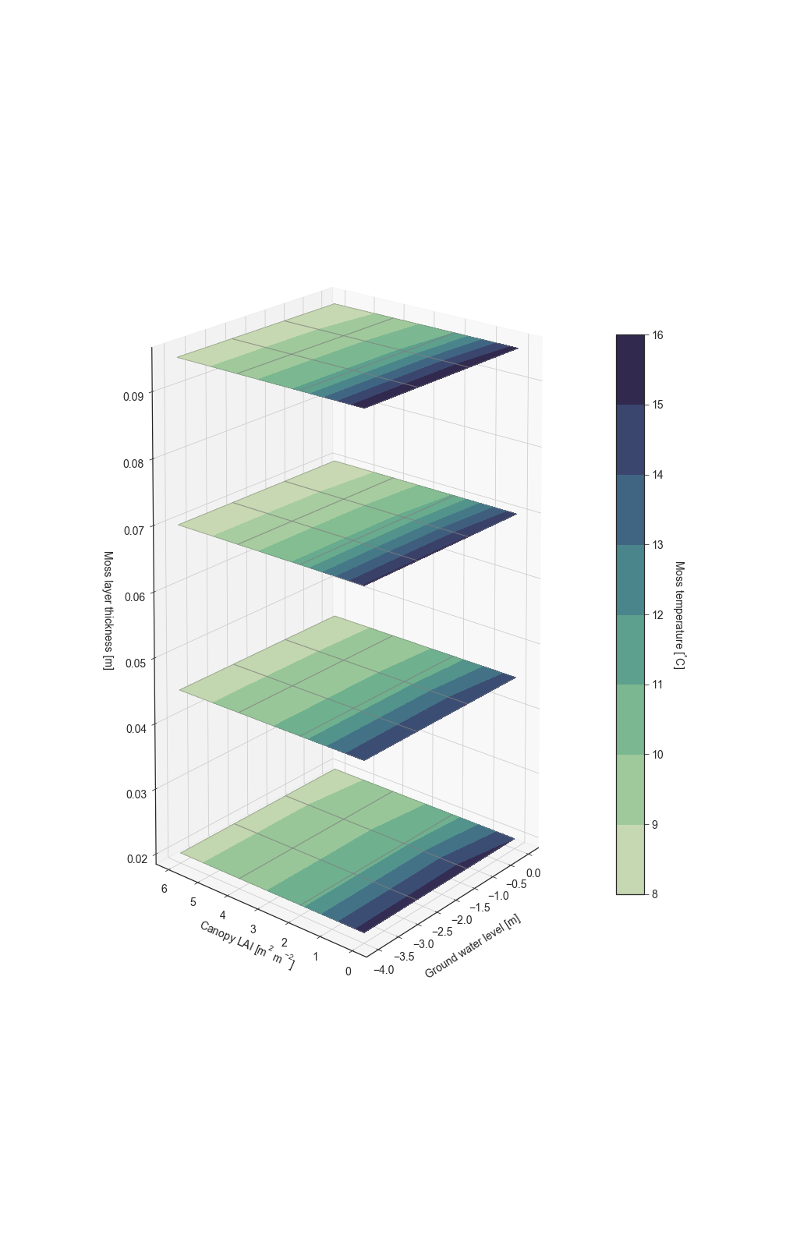

Bryophyte bulk density (kg m⁻³), layer thickness (m), and roughness length (m) VS. Bryophyte layer temperature (ºC)
a

Slide 7
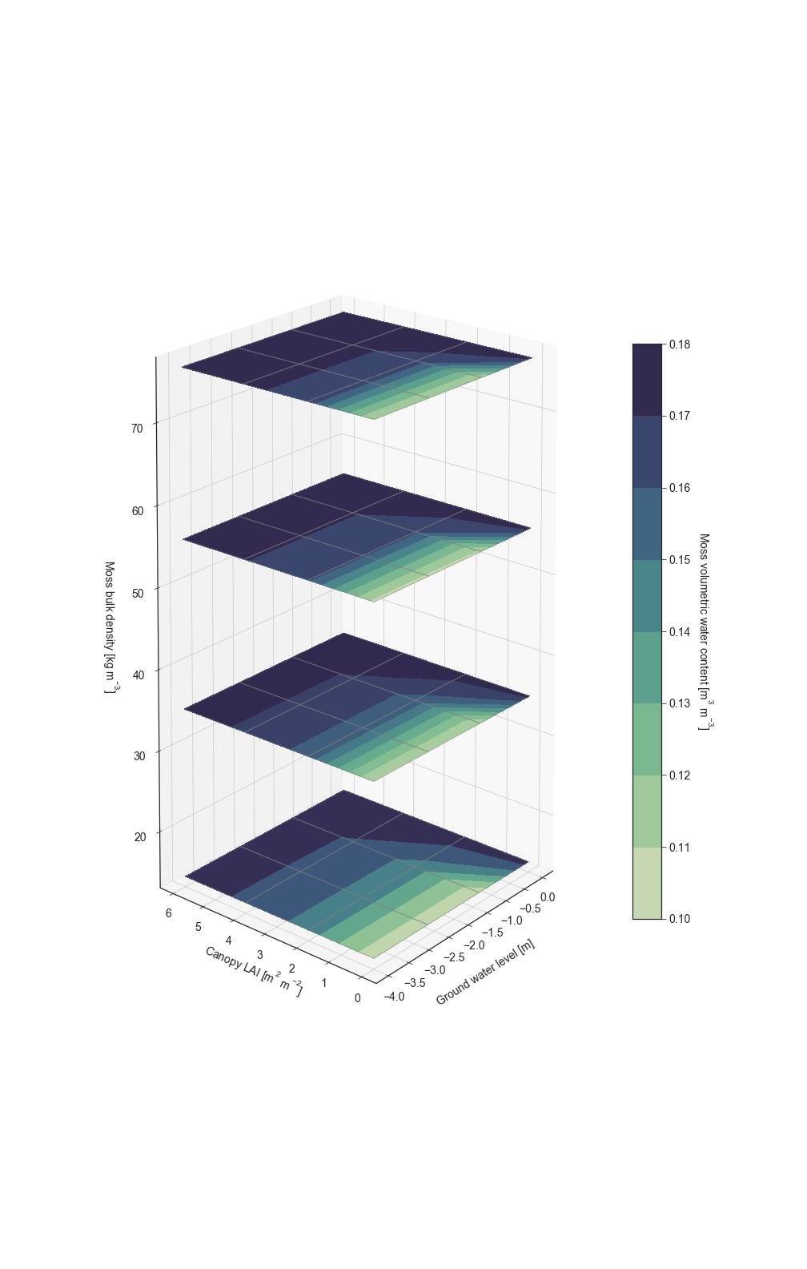
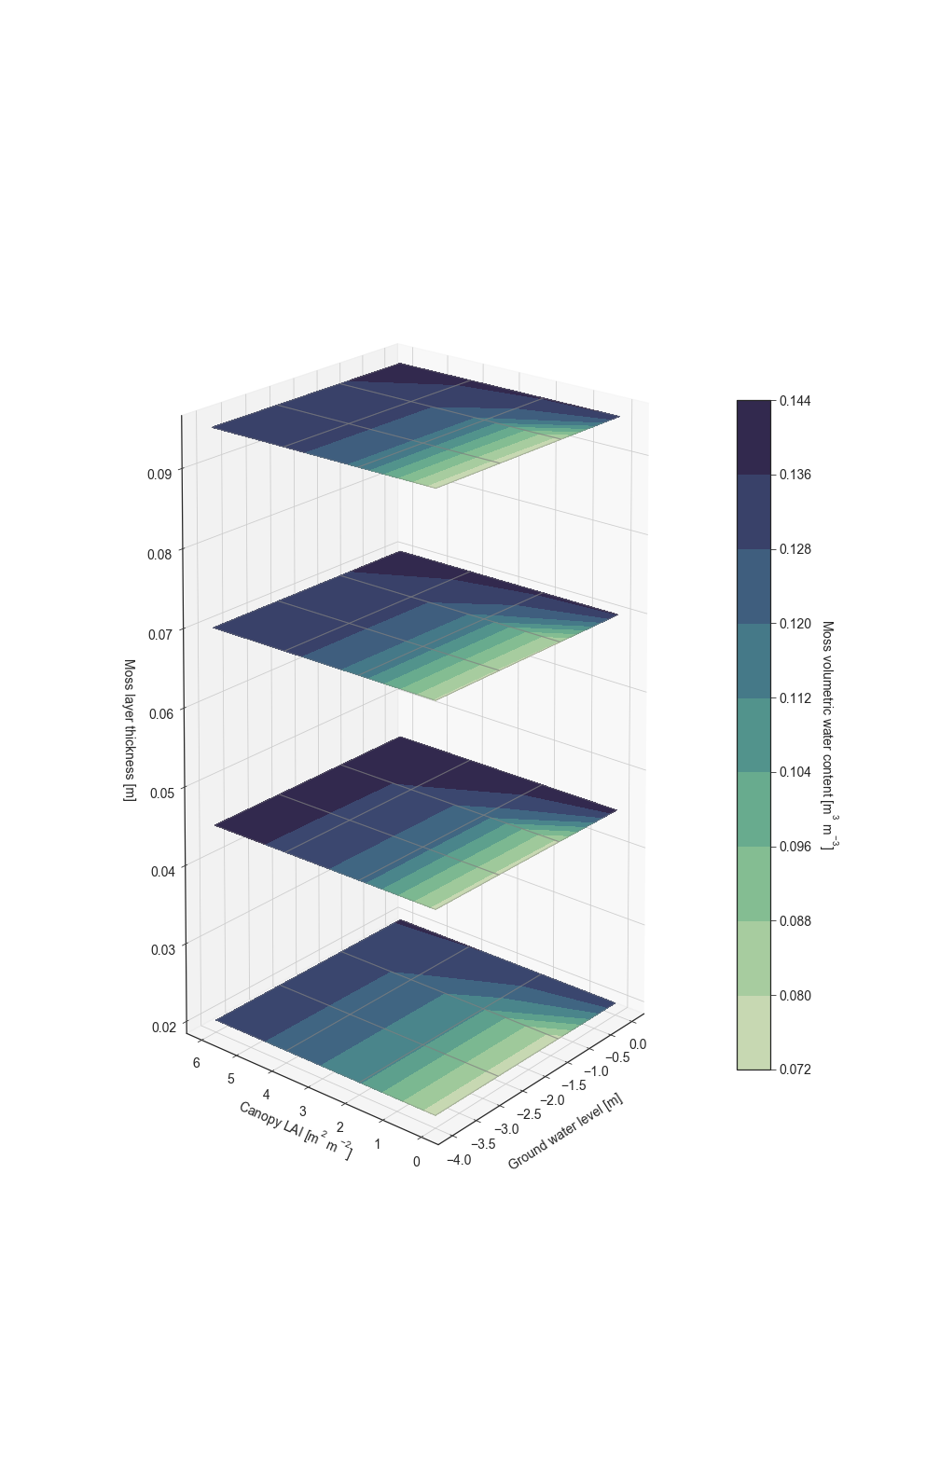
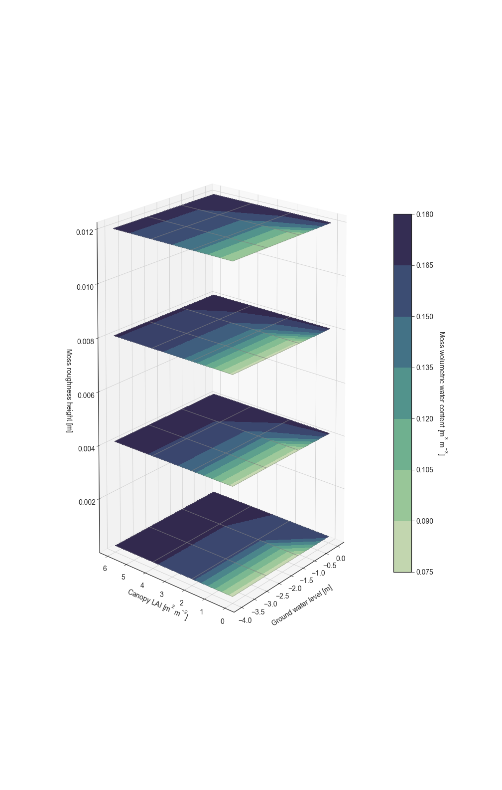
Bryophyte bulk density (kg m⁻³), layer thickness (m), and roughness length (m) VS. Bryophyte layer volumetric water content (m³ m⁻³)
a

